Slide 1

Rockbuster Stealth Data Analysis Project

Slide 2

PROJECT OBJECTIVE
The objective of this study is to support Rockbuster Stealth in creating a data-driven launch strategy by analyzing top genres, customer distribution, and sales by geography.

Slide 3
AGENDA
Descriptive Statistics Film
Top Performing Genres by Revenue
Rating by Revenue
Top 5 Movies
Top Countries by Customer Count
Top Cities Within the Top Countries
Top 5 Customers Within Top Cities
Top Sales by geography
Conclusion and Recommendation

Slide 4
DesCRIPTIVE STATISTICS FILM
Rental duration
Average 5 days
Minimum 3 days
Maximum 7 days
Rental rate
Average 2.98
Minimum 0.99
Maximum 4.99
Movie length
Average 115 minutes
Minimum 46 minutes
Maximum 185 minutes
Most common rating
PG - 13

Slide 5
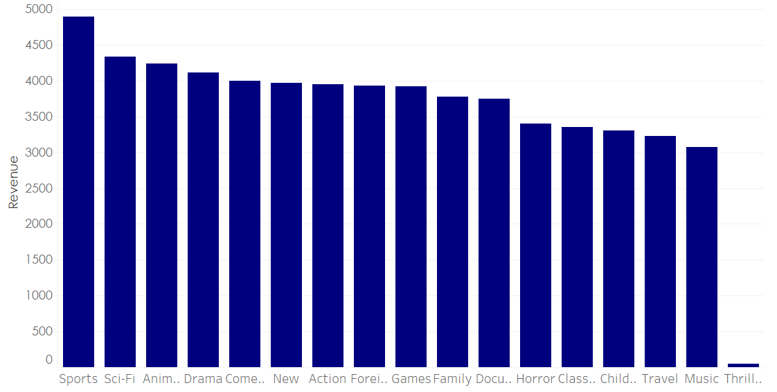
Top Performing Genres BY REVENUE
The genres that contributed the most to revenue were Sports, Sci-Fi, Animation, and Drama.
Conversely, the genres with the least revenue contribution were Thriller, Music, Travel, and Children.

Slide 6
Rating By REVENUE
PG-13
G
NC-17
PG
R
PG-13 films had the highest count of rentals and mostly contributed to the revenue, showing broad audience appeal. NC-17 followed, despite age restrictions (18+).

Slide 7
TOP 5 Movies
„Bucket Brotherhood"
„Scalawag Duck"
„Trip Newton"
„Durham Panky"
„Forrester Comancheros"

Slide 8
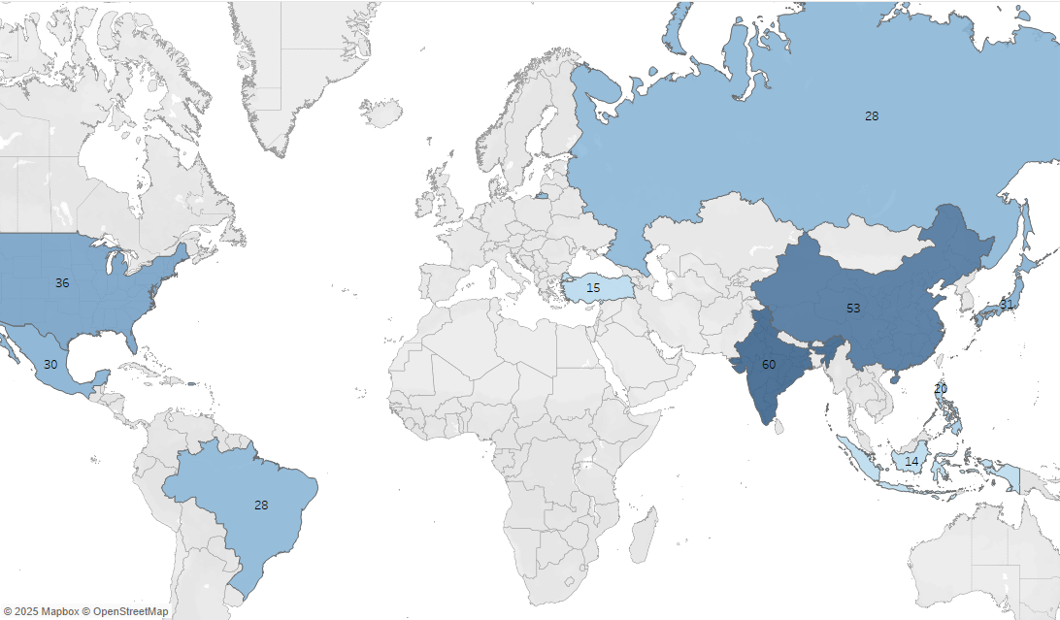

Top Countries by Customer Count
India and China had the highest number of customers, followed by the United States, Japan, and Mexico, which highlights key markets for the company’s growth.

Slide 9
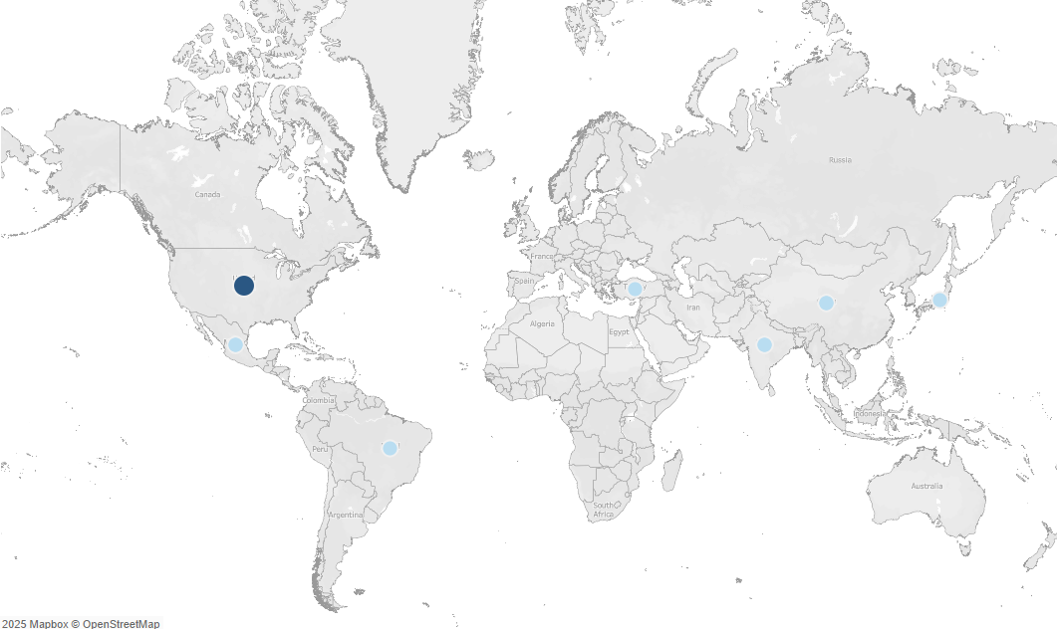
Top Cities Within the Top COUNTRIES
Aurora, United States
Atlixco, Mexico
Xintai, China
Adoni, India
Dhule, India
Kurashiki, Japan
Pingxiang, China
Sivas ,Turkey
Celaya, Mexico

Slide 10
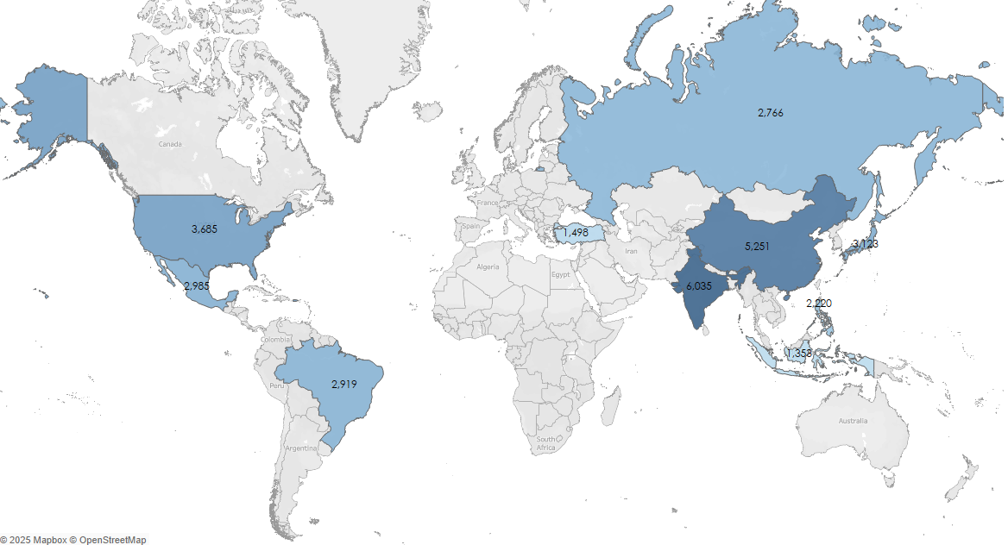
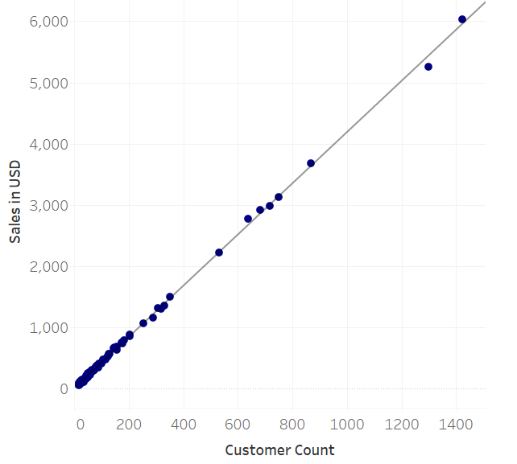
TOP 10 Sales by geography
Rockbuster Stealth recorded the highest sales in India, China, and United States. Sales increase proportionally with customer count.

Slide 11
Conclusion and Recommendation
Focus investment on top revenue genres such as Sports, Sci-Fi, Animation, and Drama.
Expand PG-13 film offerings to maximize audience reach.
Explore growth in NC-17 content due to strong performance despite age restrictions.
Strengthen presence in key markets such as India, China and USA.
Increase marketing efforts globally to acquire new customers.
Promote top 5 movies through homepage banners, ad campaigns, and promotions.
Implement loyalty programs and special rewards for top customers to boost retention.
Customize content and offers by region to match audience preferences.

Slide 12
Questions?

Slide 13
Link to Tableau Public visualizationS

